Slide 1


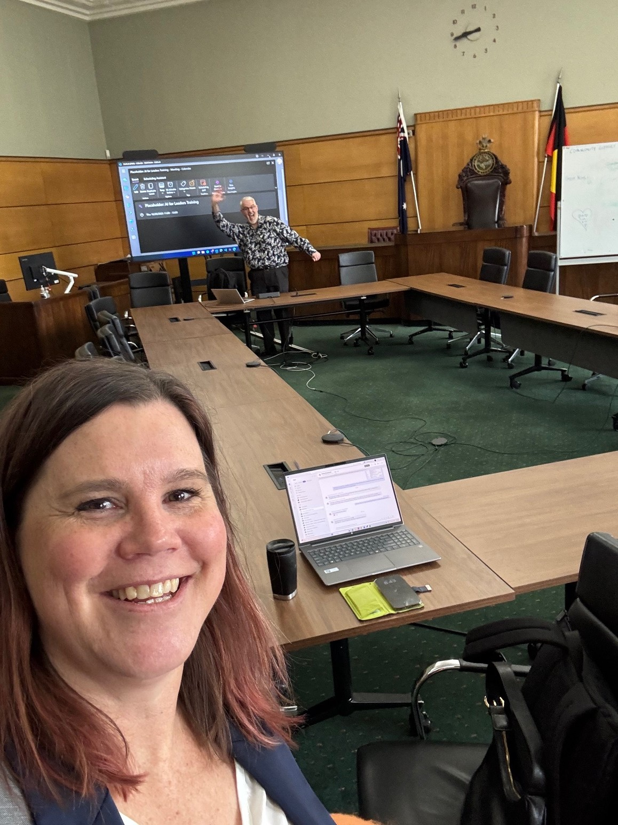
Microsoft Copilot
Innovation Lab
A workshop for Local Government
Lisa Crosbie
Copilot Lead, Barhead & Akkodis Australia | Microsoft 365 Copilot & Copilot Studio MVP

Slide 2
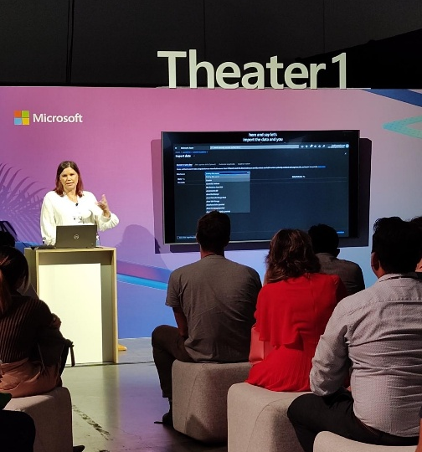

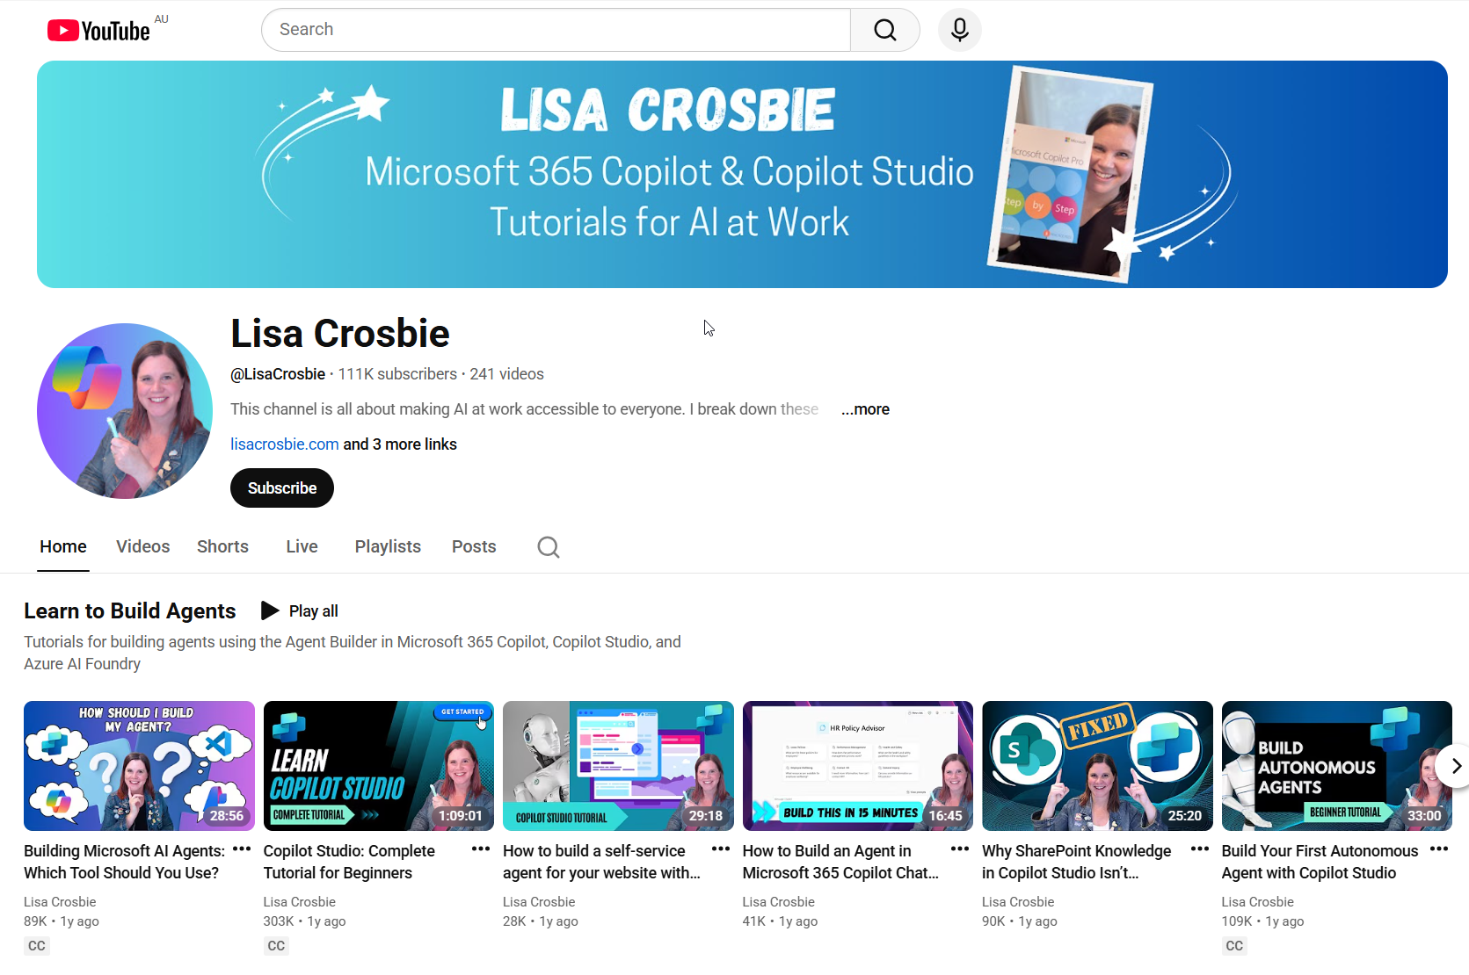
About Me
Lisa Crosbie
Copilot Lead, Akkodis Australia
Microsoft 365 Copilot & Copilot Studio MVP
2 / 42

Slide 3
Agenda
01
Prompt Masterclass
Learn the GCSE prompting framework, then practice with three hands-on exercises built around council scenarios.
02
Copilot Capabilities
Tour of Microsoft 365 Copilot — Chat, Search, Notebooks, Create, Pages, Agents and Copilot Studio.
03
Innovation Lab Challenges
Apply everything. Five hands-on challenges where you build something real with Copilot, Notebooks and Agents.
2 / 40

Slide 4
01
SECTION 01
Prompt Masterclass
The prompting skills that will change your results!
3 / 40

Slide 5
Why prompting matters
The prompt is the unlock. Same Copilot, same model — small changes in how you frame a request lead to dramatically different results.
VAGUE PROMPT
STRUCTURED PROMPT
"Summarise this planning report."
Apply Goal, Context, Source, Expectation — and you get council-ready output the first time.
What you get back
What you get back
Generic high-level overview
No focus on what actually matters to council
No structure — wall of paragraphs
Misses key dates, risks, statutory references
Targeted to the council's interests and obligations
Structured tables with risks, clauses, dates
Cites source material accurately
Right tone and length, ready to share
4 / 40

Slide 6
The GCSE prompting framework
Four elements that turn a generic question into a high-value Copilot prompt
G
C
S
E
Goal
Context
Source
Expectation
What do you want Copilot to do? Be specific about the task and the outcome you need.
What's the background? Add details about the matter, the resident, the project, the audience.
What should Copilot reference? Point to specific documents, datasets, policies or pages.
What format, tone and length? Define what good output looks like for you.
5 / 40

Slide 7
GCSE in action — worked example
A council scenario: responding to a resident's objection on a development application
G
Goal
Draft a formal response to a resident's objection letter on DA-2026-0142, addressing each concern raised so the planner can review and send.
C
Context
The objection cites overshadowing, traffic and parking. The DA is for four townhouses at 25 Willowbank Road in a GRZ1 zone. The objector lives at #27 and has lodged similar objections on three other DAs in the street. The Planning Panel hearing is on 22 May.
S
Source
Use the DA assessment report, the relevant ResCode clauses (Clause 55), and the response template used for the Smith Street objection in March.
E
Expectation
Formal but respectful tone. Address each ground of objection under its own sub-heading. Reference specific clauses and assessment findings. Maximum 600 words. Plain-English explanations next to any technical planning terms.
6 / 40

Slide 8
Beyond GCSE — three more prompting skills
Once GCSE is second nature, these are the techniques that take your prompting from good to great
01
02
03
Give feedback
Iterate the conversation
Use a persona
Don't stop at the first draft
Build on what you've already said
Frame Copilot's role
Tell Copilot what to change. "Make it warmer." "Shorter." "Cite the clause number." "Add a counter-argument we'd hear from objectors." Every round of feedback teaches Copilot what good looks like for you.
Don't start over each time. Refine, expand, branch off. "Now redo it for an internal audience." "Give me a one-page version." The conversation itself becomes a richer brief than any single prompt.
Tell Copilot who to be. "Act as a senior planning officer reviewing this DA." "You're a community engagement officer briefing residents." Personas shape tone, depth and what the response emphasises.
7 / 40

Slide 9
HANDS-ON 1
Reply to a resident complaint
SCENARIO
A resident has emailed council frustrated about a missed bin collection on their street, threatening to escalate to the Mayor and local newspaper. You need to draft a reply that's empathetic, accurate and stops it escalating.
G — Goal
C — Context
S — Source
E — Expectation
Draft a reply email to the resident that acknowledges the issue, explains what happened, and outlines what we're doing to fix it.
Suburb of Riverview, missed FOGO collection on Tuesday due to a truck breakdown. Make-good run scheduled Thursday. The resident, Margaret, is a long-time ratepayer and uses the Mayor's name.
Reference the Customer Service Charter and the published waste service standards on our website.
Under 200 words. Warm but professional tone. Address Margaret by name. Include the make-good date, an apology, and a direct contact for follow-up. No legalese.
→
TRY THIS NOW
Open Copilot Chat. Type your full GCSE prompt above. Compare what you get back with a 'just write a reply email' prompt — notice the difference in tone, specificity and confidence.
8 / 40

Slide 10
HANDS-ON 2
Turn a long report into a council briefing note
SCENARIO
The CEO has asked for a one-page briefing on a 40-page consultant's report into your council's customer experience. You need it before the executive team meeting tomorrow morning.
G — Goal
C — Context
S — Source
E — Expectation
Read the attached customer experience report and produce a one-page briefing note for the executive team.
Audience is the CEO and 6 Directors. They are time-poor, want recommendations they can decide on, and care about ratepayer impact, cost, and risk.
Use only the attached report — do not invent figures. Quote page numbers for every statistic you cite.
One page, max 400 words. Headings: Purpose, Key Findings (3 bullets), Recommendations (3 bullets), Risks, Next Steps. Plain English. Formal but readable.
→
TRY THIS NOW
Attach a long report to Copilot Chat using '/'. Run the GCSE prompt. Then ask: "What did you leave out and why?" — this is how you stress-test the summary.
9 / 40

Slide 11
HANDS-ON 3
Analyse community survey responses
SCENARIO
Council ran a community survey on a proposed dog park. You have 180 free-text responses in a spreadsheet. The Mayor wants the themes by Friday — and wants to know what the loudest minority is saying.
G — Goal
C — Context
S — Source
E — Expectation
Analyse the open-text responses in the survey and produce a themed summary of community views on the proposed dog park.
Survey ran for 4 weeks across Greenfield LGA. Respondents weighted toward residents within 1km of the proposed site. Concerns expected around noise, parking, off-leash safety.
Use only the attached survey CSV — do not generalise from outside data. Quote 2-3 verbatim responses for each theme.
Group into 5-7 themes ranked by frequency. For each: theme name, % of responses, 2 verbatim quotes, suggested council response. Add a final section: "Loudest minority view" with what's driving it.
→
TRY THIS NOW
Upload your CSV (or any spreadsheet of comments) to Copilot Chat. Run the prompt. Then ask Copilot to turn the result into a Word doc — see how it carries the structure across.
10 / 40

Slide 12
From prompt to agent
The natural progression we see in coaching sessions, every time
STEP
STEP
STEP
STEP
1
2
3
4
My prompt isn't great
Improve the prompt
This is repeatable
Build an agent
You try a basic prompt and get a generic response. "Summarise this DA" returns something you'd never put in front of a planner.
Apply GCSE. Add context, reference the planning scheme, set expectations on format and tone. Quality jumps immediately.
You realise you do this task every week — every new DA, every new infringement, every new contract. The same good prompt works every time.
Capture the refined instructions in a Copilot Agent. Now your whole team gets consistent, high-quality output without writing the prompt.
11 / 40

Slide 13
Common pitfalls
What we hear, and how to think about each one
"It can't access our documents"
"Is it safe to use with citizen data?"
Copilot works inside Microsoft 365. Reference files via OneDrive, SharePoint, or by attaching them in chat with /.
Data stays in your M365 tenant. Copilot follows your existing security and privacy boundaries. Nothing is used to train models.
"It made something up"
"I tried it and it wasn't very good"
Copilot can hallucinate citations and clause numbers. Ground agents in real source documents, and always verify against the source.
Almost always a prompting problem, not a tool problem. Apply GCSE to the same task and the result transforms.
12 / 40

Slide 14
02
SECTION 02
Copilot Capabilities
What Microsoft 365 Copilot can do across your day-to-day work
13 / 40

Slide 15

Copilot + Agents
Two halves of the same story
Copilot
Agents
Every employee will have one
Every business process will have one
Works as your personal assistant
The UI for AI
Grounded in your work content — email, meetings, documents
Available across Teams, Outlook, Word, Excel, PowerPoint and the web
AI systems with actions, triggers and knowledge
Work on behalf of employees, teams or whole functions
Connected to Copilot or running autonomously
Built by IT or by everyday users in Copilot Studio
14 / 40

Slide 16
Know your Copilot experiences
What's the difference between Copilot Chat and Microsoft 365 Copilot?
Copilot Chat
Microsoft 365 Copilot
Free for everyone with a Microsoft 365 account
Licensed experience with full access to your work data
Grounded in web data by default
Reason over uploaded files or files referenced via /
Suggested prompts personalised to your work
Enterprise data protection on every prompt
Access to your organisation's SharePoint, OneDrive, email, meetings, chats
Powered by Work IQ — understands your context, workflows and relationships
Embedded in Outlook, Teams, Word, Excel, PowerPoint
Memory and personalisation tuned to how you work
15 / 40

Slide 17
What's in Microsoft 365 Copilot
A connected suite of capabilities, all in one app
1
Chat
2
Search
3
Agents
Secure AI chat with the latest models and Work IQ as the intelligence layer.
AI search across M365, on-prem and 100+ third-party connectors.
Pre-built agents in the Agent Store, plus build your own with Agent Builder.
4
Create
5
Notebooks
6
Pages
AI-generated images, documents, spreadsheets and more.
Multi-source workspaces grounded in mixed content for richer responses.
Live, shared canvases for ideas - refine with Copilot and your colleagues together.
16 / 40

Slide 18
Copilot use cases
Real moments where Copilot already shines for council teams
Prepare for a resident meeting
Get proactive overviews of your day
Never take meeting notes again
Interpret multilingual conversations live
Researcher
Copilot Chat
Facilitator
Interpreter
Automate reminders and tasks
Quickly find content
Jumpstart document drafting
Onboard quickly to new roles or projects
Workflows
Copilot Search
Agent Mode in Word
Notebooks
17 / 40

Slide 19
Multi-model Copilot
Choose the right model for the job — GPT, Claude and more, all inside Copilot
Model choice
Why multi-model matters
Different models excel at different tasks. Copilot now orchestrates across OpenAI and Anthropic so you always get the best result for the job at hand.
in Copilot Chat, Researcher and Studio
GPT-5.2 — fast, general-purpose reasoning across everyday work tasks
Claude Sonnet — deep reasoning, agentic tasks, polished content
Switch models from the selector — match the engine to the task
Researcher can run on Claude Opus for deeper multi-step analysis
Critique mode pairs GPT drafting with Claude review for higher accuracy
Enterprise data protection applies to all models — your data stays in your tenant
18 / 40

Slide 20
Agent Mode in Word, Excel & PowerPoint
Copilot orchestrates multi-step tasks to produce real Office documents
Word
Excel
PowerPoint
Update reports, rewrite executive summaries, restructure long documents.
Build forecasts, run sensitivity analysis, create charts and dashboards.
Rewrite, re-layout, insert tables and images, edit across slides.
Integrated with Office
Grounded in trusted sources
Transparent and reviewable
Real Word styles, Excel formulas, PowerPoint layouts – not just copy/paste text.
Files, emails, meetings via Work IQ; web grounding when needed.
Every change explained and adjustable. You stay in control.
19 / 40

Slide 21
Search
Enterprise search powered by AI and Work IQ
Intelligent search
Broad connector ecosystem
Authoritative answers
Natural-language queries combined with semantic indexing surface deeper, more relevant answers.
Search across Microsoft 365, on-premises systems and 100+ line-of-business connectors.
Admins curate concise, trusted answers that are especially relevant to your council.
21 / 40

Slide 22
Notebooks
Pull together notes, documents and meetings into one Copilot-grounded workspace
Intelligent workspace
Suggestions and updates
Audio overviews
Holds diverse content types in a single place. Copilot is grounded in the notebook, so answers are more relevant.
Smart suggestions recommend additional content. Updates to source material flow through automatically.
AI-generated podcast-style summaries help you catch up on a topic and share it with your team.
22 / 40

Slide 23
Create
Generate and edit visual content tuned to your council brand
AI-powered creation
Brand kit
Full editing experience
Design visuals — images, banners, infographics, video — personalised to you and your organisation.
Apply your council's logos, colours and fonts so every output is on-brand by default.
Built-in tools to edit text, add effects, and make sophisticated adjustments without leaving Copilot.
23 / 40

Slide 24
Memory and personalisation
Tailored responses that understand how you work
Chat history-aware
Work IQ-powered
Copilot uses your previous chats to provide contextual, relevant responses.
Personalisation draws on your emails, chats, meetings and other M365 data.
Agents tap into memory
You stay in control
Microsoft agents can use Copilot memory to deliver tailored responses.
View, manage, disable or clear memory any time. Use a temporary chat for sensitive work.
24 / 40

Slide 25
Advanced scheduling in Outlook
Triage meeting requests, negotiate conflicts, schedule with natural language
1
2
3
Keep your calendar updated
Negotiate conflicts
Schedule in natural language
Copilot triages meeting requests against your custom rules and surfaces what needs attention.
Mark 1:1s and personal events as flexible — Copilot reschedules them when conflicts arise.
Tell Copilot what you need — schedule, update, cancel, set agendas, book rooms — and it does it.
25 / 40

Slide 26
Copilot Pages
Turn ideas into impact — Pages now build, refine, and present for you
Convert to Word
Auto-create from chat
Code in Pages
Transform a Copilot Page into a Word document, preserving content and structure.
Copilot listens for actionable intent in chats, builds a Page automatically, and lets you refine it live.
Write, test and run interactive code directly in Pages, then deploy as an app via App Builder.
26 / 40

Slide 27
Agents
Use Microsoft agents, discover them in the store, or build your own
Use Microsoft agents
Discover in the Agent Store
Build your own
Pre-built agents like Researcher, Analyst, and Facilitator - purpose-built reasoning for work tasks.
Microsoft and trusted third-party agents are ready to work for you across your organisation.
Use natural language to describe the agent you want to build and start using it immediately.
27 / 40

Slide 28
Microsoft agents
Pre-built agents from Microsoft, designed for work
Researcher
Analyst
Facilitator
Interpreter
Advanced reasoning research
Data and insights
Teams meeting moderation
Multilingual translation
Surveys
Knowledge
Project Manager
Workforce Insights
End-to-end survey management
Content management & organisation
Automate project management
Organisational insights
Channels
PowerPoint
Excel
Word
AI teammate in Teams
Build and iterate decks
Data visualisation and insights
Document creation and iteration
28 / 40

Slide 29
FRONTIER
Frontier Program
Early access to the latest Copilot features before general availability
28 / 42

Slide 30
Copilot Cowork
Delegate real work to Copilot and get results, not just answers
Describe the outcome
Delegate
Tell Cowork what you need in plain language. It builds a plan, executes across your apps, and checks in along the way.
entire tasks and take action
Works across M365
Cowork goes beyond chat. Describe an outcome and it plans, executes, and delivers real work across your Microsoft 365 environment.
Powered by Work IQ, Cowork draws on signals from Outlook, Teams, Excel and SharePoint to act with full context.
You stay in control
Clear checkpoints let you confirm progress, steer direction, or approve actions before anything is sent or changed.
30 / 41

Slide 31
App Builder
Empower people to build the apps they need, when they need them
Build interactive apps in minutes
No-code
Boost personal and team productivity without writing code.
apps in minutes
Use the data you already have
Describe what you want in plain language. App Builder generates an interactive app you can share like a document.
Start quickly using your existing Microsoft Graph data and documents.
Share and launch in M365 Copilot
Share with coworkers like a document; launch directly inside Copilot.
29 / 40

Slide 32
Workflows
Create automations directly in chat using natural language
Build in chat
Across Microsoft 365
Smart triggers
Describe the automation in natural language — Copilot turns it into a working flow.
Automate work across Outlook, Teams, SharePoint, Planner and Excel.
Run on a schedule or on events — new email, meeting, file update, approval request.
30 / 40

Slide 33
Copilot Studio
The platform for building, customising and managing your AI agents
Transform processes with low code agents
Add deterministic workflows
Manage and secure at scale
Choose from 1,500+ connectors, data sources, actions and channels to handle your business processes.
Eliminate repetitive tasks with rules-based workflows - standalone, or embedded inside an agent.
IT keeps full visibility, security and compliance controls across every agent in the organisation.
31 / 40

Slide 34
03
SECTION 03
Innovation Lab
Choose your own adventure and build something real!
32 / 40

Slide 35
Copilot Innovation Lab
The Innovation Lab is where prompting becomes practice. You'll combine GCSE prompting with Copilot Chat, Notebooks, and Agents to build solutions you can take back to your council on Monday.
Prompt with intent
Combine capabilities
Apply GCSE to every interaction. Improve, refine, repeat, until the output earns its place in your work.
Pull Notebooks, Chat, SharePoint and Agents together. The real magic is in the combinations, not any single tool.
Build something real
Share what you learn
Don't just experiment - finish a deliverable. A briefing, an agent, a workflow your team can actually use.
We finish the day with show-and-tell. Bring back what worked, what didn't, and what you'll keep using.
33 / 40

Slide 36
Choose your challenge
75 minutes to build, 15 minutes to share. Pick the scenario closest to your day job.
01
Contract Reviews
M365 Copilot Chat
Beginner
Analyse supplier contracts and produce an approval brief.
02
SharePoint Agent
M365 Copilot Chat
Beginner
Build an agent that answers questions from your SharePoint policies.
03
Copilot Notebook
M365 Copilot Chat
Beginner
Assess a Development Application against the planning scheme.
04
Road Rules Explainer
Declarative Agent
Intermediate
Help citizens understand infringement notices and the rules.
05
HR Recruitment Assistant
Declarative Agent
Intermediate
Evaluate, rank and interview candidates against a job description.
34 / 40

Slide 37
CHALLENGE
01
Use Copilot Chat for Contract Reviews
Level
Platform
Time
Beginner
M365 Copilot Chat
20-30 mins
SCENARIO
Greenfield City Council manages a mixed fleet of vehicles used by local laws, parks, community services, waste oversight, facilities and depot operations. To improve uptime and simplify vendor management, the Council is entering a 3-year Fleet Maintenance Services Agreement with Southern Cross FleetCare Pty Ltd. The supplier-authored draft is the basis for negotiation. Procurement & Contract Management need a rapid first-pass risk review before the Steering Committee meets.
YOUR GOAL
DATA FILES
Instruct Copilot to summarise the contract — main clauses, key dates, contractual risks. Present the risks in a table with risk area, specific details and recommended ways to address. Then make Copilot draft an approval brief using the council's approval brief template.
Fleet Maintenance Services Agreement
Approval Brief Template
35 / 40

Slide 38
CHALLENGE
02
SharePoint Agent
Level
Platform
Time
Beginner
M365 Copilot Chat
20-30 mins
SCENARIO
Council teams use SharePoint to store internal policies, work procedures, guidelines and standard templates. Before starting work, staff often need to verify compliance with multiple policy and process documents. Considerable time goes into reviewing these protocols — missed requirements lead to rework or, more seriously, non-compliance.
YOUR GOAL
DATA FILES
Pick a workflow in your area where SharePoint is the system of record for knowledge. Build a Copilot Agent that answers questions about the existing processes or policies stored there, so colleagues can self-serve instead of hunting through documents.
Use your own SharePoint site as the knowledge source
36 / 40

Slide 39
CHALLENGE
03
Copilot Notebook — Development Application
Level
Platform
Time
Beginner
M365 Copilot Chat
20-30 mins
SCENARIO
You are a Planning Officer at Greenfield City Council, assessing a planning permit application for four double-storey townhouses at 25 Willowbank Road, in a General Residential Zone. The proposal seeks to increase density near services and an activity centre, but includes variations from key planning controls - building height, site coverage, setbacks and overlooking. Multiple residents have objected on neighbourhood character, overshadowing, privacy, traffic and parking.
YOUR GOAL
DATA FILES
Build a Copilot Notebook that brings the planning scheme, the development application and the objection letters together, so you can rapidly assess against state and local planning policies, ResCode (Clause 55), amenity impacts and community submissions.
Planning Scheme
Development Application
Objection Letters
37 / 40

Slide 40
CHALLENGE
04
Road Rules Explainer
Level
Platform
Time
Intermediate
Declarative Agent
30-40 mins
SCENARIO
Citizens regularly contact the council about infringement notices and want to understand exactly why they were issued and what rule applies. Your team has a CSV with infringement cases and a set of publicly available Road Safety regulations. The challenge is to give residents clear, grounded answers without taking up officer time.
YOUR GOAL
DATA FILES
Build a custom declarative agent that helps explain infringement notices to citizens. Connect the agent to the Road Safety regulations and the infringement cases data file. Test it with: "Why is RSI-2026-0006 an infringement?"
Road Safety Infringement Cases.csv
Public Road Safety regulations
38 / 40

Slide 41
CHALLENGE
05
HR Recruitment Assistant
Level
Platform
Time
Intermediate
Declarative Agent
30-40 mins
SCENARIO
Greenfield City Council is recruiting a Senior Business Analyst to support the council's Copilot rollout and broader business transformation aligned to its AI strategy. Three candidates have applied: Emily Carter (8 years across Australian local government), Michael Tan (6 years across utilities and financial services) and Priya Nair (6 years in reporting and operational decision support).
YOUR GOAL
DATA FILES
Create an agent that: 1) Evaluates each resume against the job description to identify suitability, strengths and gaps. 2) Ranks the candidates against the criteria. 3) Generates interview questions following the STAR method (Situation, Task, Action, Result).
Job Description — Senior Business Analyst
Three Candidate Resumes
39 / 40

Slide 42
Now build something real.
Pick your scenario,share what you build.

